Slide 1
Distributed Databases
(Part 1)

Slide 2
Definition of Distributed Databases
A distributed database (DDB) can be defined as:
  a single logical database which is physically distributed across computers in multiple locations, that are connected by a computer network.
A distributed database management system (DDBMS) can then be defined as:
  the software system that facilitates the management of the DDBs and makes the distribution transparent to the users.

Slide 3
Distributed vs Decentralised Databases
A decentralised database is also stored on computers at multiple locations. However, the computers are not connected by a network. Consequently, data cannot be shared by users at different locations (sites).
Thus a decentralised database is best regarded as a collection of independent databases, rather than having the geographical distribution of a single database .

Slide 4
Advantages of Distributed Databases
Some typical advantages:
  reflecting distributed nature of some database applications
  increased reliability and availability
  local control
  lower communication costs
  fast response and improved performance
  interconnection of existing databases

Slide 5
Advantages of Distributed Databases
reflecting distributed nature of some database applications
Many database applications are naturally distributed over some different locations (e.g. a company may have locations in different cities)
increased reliability and availability
When a centralised system fails, the database is unavailable to all users. A distributed system however will continue to function at some reduced level even when a component fails.
local control
Data distribution in a distributed database encourages local groups to exercise greater control over "their" data. This promotes improved data integrity and administration. At the same time, users can still access non-local data when necessary.

Slide 6
Advantages of Distributed Databases
lower communication costs
With a distributed system data can be located closer to the point of use. This can reduce communication costs when compared to a centralised system.
fast response and improved performance
  By distributing a large database over multiple sites, smaller databases exist at each site. Some user queries at a particular site may only need to access their smaller database stored locally. This speeds up query processing and enhances database performance.
  It may also be possible to decompose complex queries into sub-queries that can be processed in parallel at several different sites.

Slide 7
Advantages of Distributed Databases
interconnection of existing databases
  When several databases already exist in an organisation and the necessity of performing global applications arises, the distributed database often offers a natural solution by integrating and interconnecting the pre-existing local databases.

Slide 8
Disadvantages of Distributed Databases
Some typical disadvantages / difficulties:
Software cost and complexity
This is far greater for distributed environment than for a centralised system.
Communication/Processing overheads
These are much greater because the various sites must exchange messages and perform additional calculations to ensure proper co-ordination among the sites. There is always the risk that the communication overhead may degrade system responsiveness and performance.

Slide 9
Disadvantages of Distributed Databases
Data Integrity and consistency
Given the increased complexity of the system and the need for co-ordination from multiple sites, additional control mechanisms are required in order to prevent improper updating of data and avoid other problems of data integrity/consistency.

Slide 10
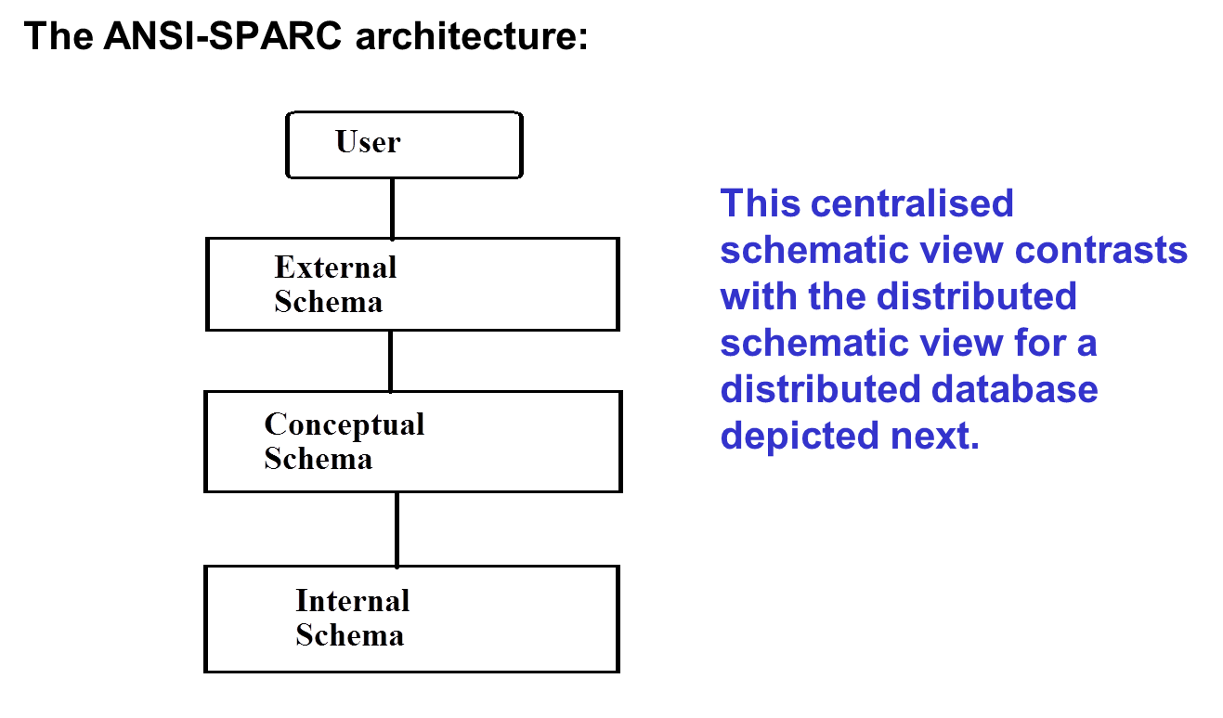
Centralised Schematic View - Revisited

Slide 11
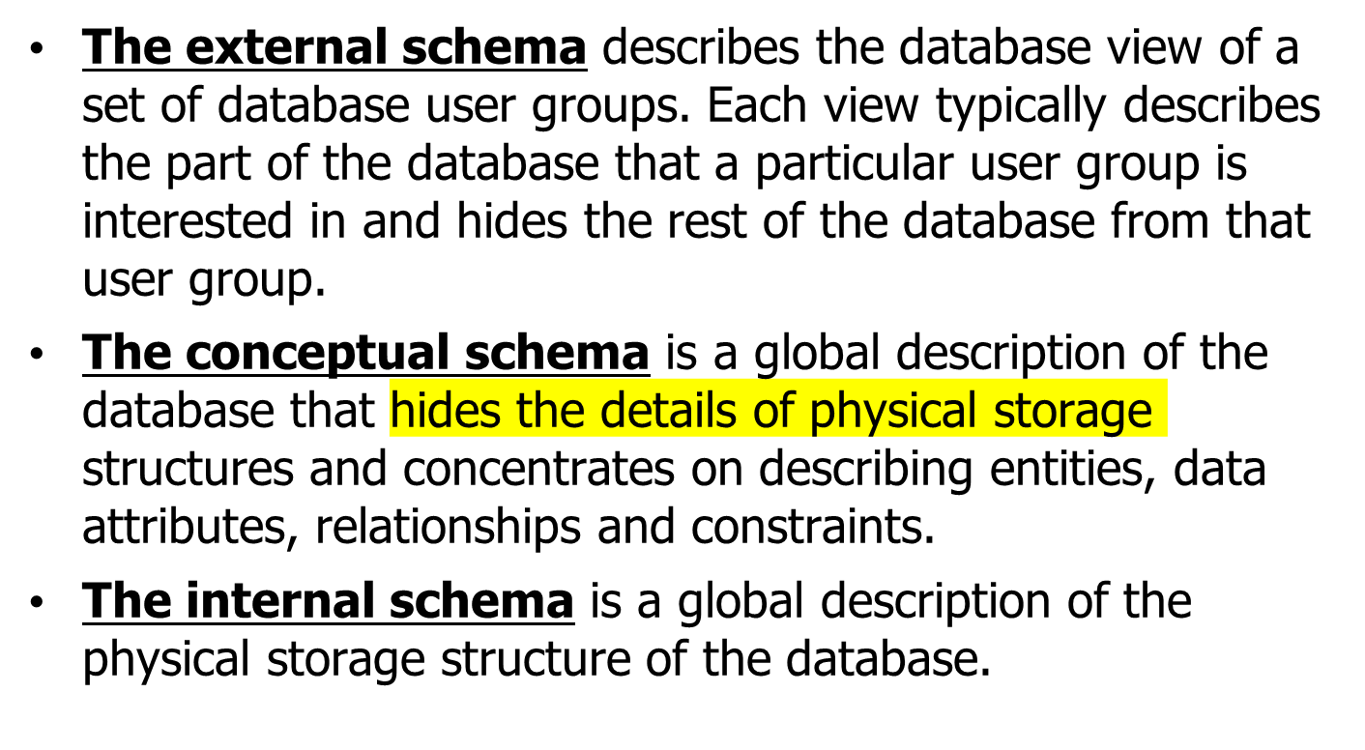
Centralised Schematic View - Revisited

Slide 12
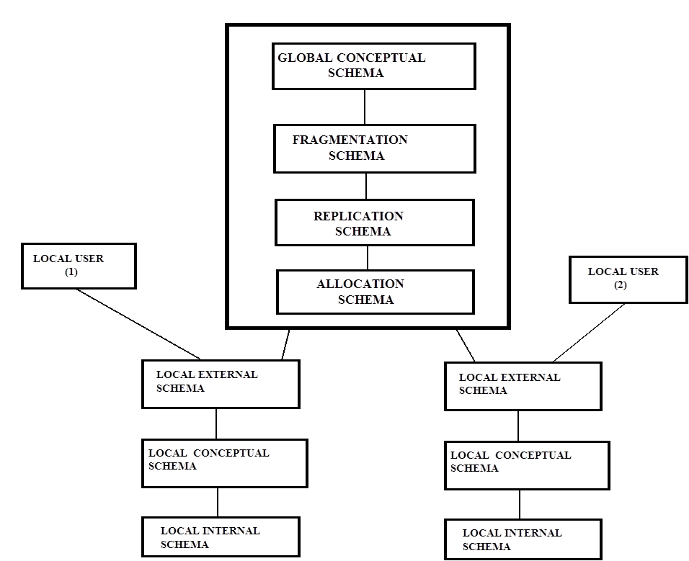
Distributed Schematic View

Slide 13
Distributed Schematic View
At the top level the distributed database acts conceptually as a single centralized database. So the global conceptual schema, which defines all the data contained in the distributed database, represents to the end users a unified view of data for the complete distributed system.
A set of end users interact with the global schema with their own local schemas, each conforming to the ANSI-SPARC three level architecture. These users' external schemas are the subsets of the global conceptual schemas.
Note that in a centralised database external schemas use subsets of the conceptual schema, whilst in the distributed environment local external schemas describe subsets of the global conceptual schema.

Slide 14
Summary
Definition of DDBs and DDBMSs
Advantages and disadvantages of DDBs
Distributed schematic view of a DDB

Slide 15
Bibliography
Connolly, T.M. &Begg, C.E., 2009. Database Systems: A Practical Approach to Design, Implementation and Management 5th ed., Addison Wesley. ISBN-0321523067
Date, C. J. 2004. An Introduction to Database Systems (8th ed.), Addison­Wesley, ISBN-0321197844

